Slide 1


Slide 2
Chapter 16
Operations Scheduling

Slide 3

OBJECTIVES
Work Center Defined
Typical Scheduling and Control Functions
Job-shop Scheduling
Examples of Scheduling Rules
Shop-floor Control
Principles of Work Center Scheduling
Issues in Scheduling Service Personnel
Notes:
2

Slide 4

Work Center
Defined
A work center is an area in a business in which productive resources are organized and work is completed
Can be a single machine, a group of machines, or an area where a particular type of work is done
Notes:
3

Slide 5
Capacity and Scheduling
Infinite loading (Example: MRP)
Finite loading
Forward scheduling
Backward scheduling (Example: MRP)
Notes:
4

Slide 6
Types of Manufacturing Scheduling Processes and Scheduling Approaches
Type of Process
Typical Scheduling Approach
Continuous
process
Finite forward of process, machine limited
High-volume manufacturing
Finite forward of line, machined limited
Med-volume manufacturing
Infinite forward of process, labor and machined limited
Low-volume manufacturing
Infinite forward of jobs, labor and some machine limited
Notes:
4

Slide 7
Typical Scheduling and Control Functions
Allocating orders, equipment, and personnel
Determining the sequence of order performance
Initiating performance of the scheduled work
Shop-floor control
Notes:
5

Slide 8
Work-Center Scheduling Objectives
Meet due dates
Minimize lead time
Minimize setup time or cost
Minimize work-in-process inventory
Maximize machine utilization
Notes:
6

Slide 9
Priority Rules for Job Sequencing
1. First-come, first-served (FCFS)
2. Shortest operating time (SOT)
3. Earliest due date first (DDate)
4. Slack time remaining (STR) first
5. Slack time remaining per operation (STR/OP)
Notes:
7

Slide 10
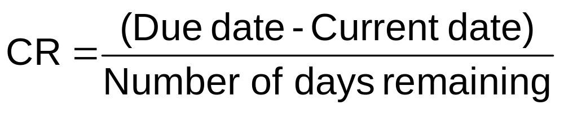
Priority Rules for Job Sequencing (Continued)
6. Critical ratio (CR)
7. Last come, first served (LCFS)
8. Random order or whim
Notes:
8

Slide 11
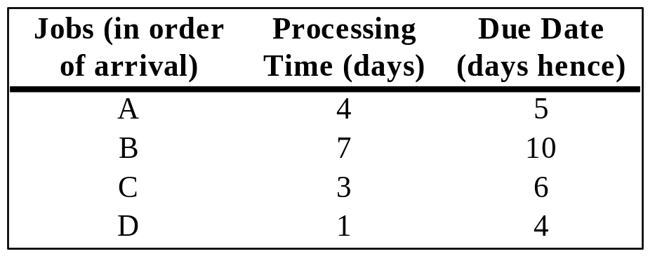
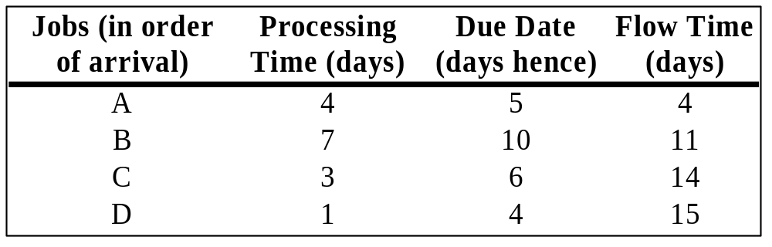
Example of Job Sequencing: First-Come First-Served
Suppose you have the four jobs to the right arrive for processing on one machine
What is the FCFS schedule?
Do all the jobs get done on time?
Answer: FCFS Schedule
No, Jobs B, C, and D are going to be late
Notes:
10

Slide 12
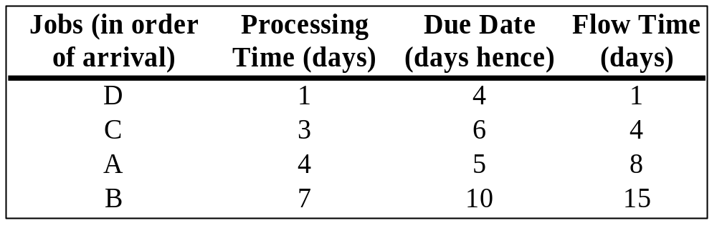
Example of Job Sequencing: Shortest Operating Time
Suppose you have the four jobs to the right arrive for processing on one machine
What is the SOT schedule?
Do all the jobs get done on time?
Answer: Shortest Operating Time Schedule
No, Jobs A and B are going to be late
Notes:
11

Slide 13
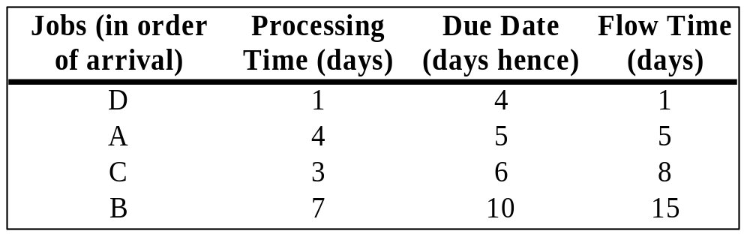
Example of Job Sequencing: Earliest Due Date First
Suppose you have the four jobs to the right arrive for processing on one machine
What is the earliest due date first schedule?
Do all the jobs get done on time?
Answer: Earliest Due Date First
No, Jobs C and B are going to be late
Notes:
13

Slide 14
Example of Job Sequencing: Critical Ratio Method
Suppose you have the four jobs to the right arrive for processing on one machine
What is the CR schedule?
Do all the jobs get done on time?
In order to do this schedule the CR’s have be calculated for each job. If we let today be Day 1 and allow a total of 15 days to do the work. The resulting CR’s and order schedule are:
CR(A)=(5-4)/15=0.06 (Do this job last)
CR(B)=(10-7)/15=0.20 (Do this job first, tied with C and D)
CR(C)=(6-3)/15=0.20 (Do this job first, tied with B and D)
CR(D)=(4-1)/15=0.20 (Do this job first, tied with B and C)
No, but since there is three-way tie, only the first job or two will be on time
Notes:
13

Slide 15
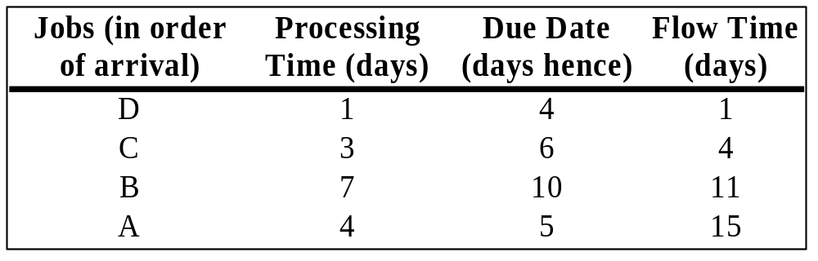
Example of Job Sequencing:
Last-Come First-Served
Suppose you have the four jobs to the right arrive for processing on one machine
What is the LCFS schedule?
Do all the jobs get done on time?
Answer: Last-Come First-Served Schedule
No, Jobs B and A are going to be late
Notes:
12

Slide 16
Example of Job Sequencing: Johnson’s Rule (Part 1)
Suppose you have the following five jobs with time requirements in two stages of production. What is the job sequence using Johnson’s Rule?
Time in Hours
Jobs Stage 1 Stage 2
A 1.50 1.25
B 2.00 3.00
C 2.50 2.00
D 1.00 2.00
Notes:
13

Slide 17
Example of Job Sequencing: Johnson’s Rule (Part 2)
First, select the job with the smallest time in either stage.
Time in Hours
Jobs Stage 1 Stage 2
A 1.50 1.25
B 2.00 3.00
C 2.50 2.00
D 1.00 2.00
That is Job D with the smallest time in the first stage. Place that job as early as possible in the unfilled job sequence below.
Drop D out, select the next smallest time (Job A), and place it 4th in the job sequence.
Drop A out, select the next smallest time. There is a tie in two stages for two different jobs. In this case, place the job with the smallest time in the first stage as early as possible in the unfilled job sequence.
Then place the job with the smallest time in the second stage as late as possible in the unfilled sequence.
Job Sequence 1 2 3 4
Job Assigned D
B
C
A
Notes:
13

Slide 18
Shop-Floor Control:
Major Functions
1. Assigning priority of each shop order
2. Maintaining work-in-process quantity information
3. Conveying shop-order status information to the office
Notes:
14

Slide 19
Shop-Floor Control:
Major Functions (Continued)
4. Providing actual output data for capacity control purposes
5. Providing quantity by location by shop order for WIP inventory and accounting purposes
6. Providing measurement of efficiency, utilization, and productivity of manpower and machines
Notes:
15

Slide 20
Input/Output Control
Work
Center
Input
Output
Planned input should never exceed planned output
Focuses attention on bottleneck work centers
Notes:
17

Slide 21
Principles of Work Center Scheduling
1. There is a direct equivalence between work flow and cash flow
2. The effectiveness of any job shop should be measured by speed of flow through the shop
3. Schedule jobs as a string, with process steps back-to-back
4. A job once started should not be interrupted
Notes:
18

Slide 22
Principles of Job Shop Scheduling (Continued)
5. Speed of flow is most efficiently achieved by focusing on bottleneck work centers and jobs
6. Reschedule every day
7. Obtain feedback each day on jobs that are not completed at each work center
8. Match work center input information to what the worker can actually do
Notes:
19

Slide 23
Principles of Job Shop Scheduling (Continued)
9. When seeking improvement in output, look for incompatibility between engineering design and process execution
10. Certainty of standards, routings, and so
forth is not possible in a job shop, but
always work towards achieving it
Notes:
20

Slide 24
Personnel Scheduling in Services
Scheduling consecutive days off
Scheduling daily work times
Scheduling hourly work times
Notes:
21

Slide 25
End of Chapter 16

